Slide 1
Canny edge detection – fpga speedup
David watts
Max dunevitz

Slide 2
Software implementation
Using OpenCV libraries to accomplish Canny Edge Detection in C++
Currently does hysteresis thresholding too, but take out later
Fully functional

Slide 3
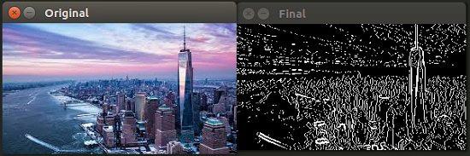
Software output

Slide 4
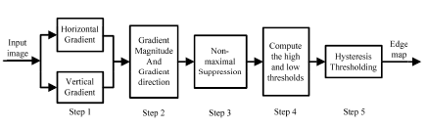
Software with hardware STEPS
Notes:
Max, on this slide I would like to circle the parts that software does and what part the FPGA will be responsible for

Slide 5
Current progress: memory mapping
3 input RAM’s
Each RAM contains N-1 rows of pixels from the input image (N is number of rows in image)
CPU will be writing identical data to each RAM with some offset
This allows us to “unroll” the datapath 3 times
Software can now write 16-bit magnitude and 16-bit angle for each pixel

Slide 6
Current Progress: Datapath
Writing base datapaths for non-maximal suppression (NMS) and thresholding
Synthesize and test with a single iteration (no unrolling)
Implement unrolling for greater speedup
NMS block
Input: Magnitudes (8-bit integers) of all pixels in a 3x3 square and the direction (3-bit integer) of the center pixel
Output: single bit indicating that the pixel is kept (1) or suppressed (0)
Thresholding
Input: Magnitude of the center pixel
Output: two bits indicating that the pixel is passes (1) or fails (0) the high/low thresholds

Slide 7
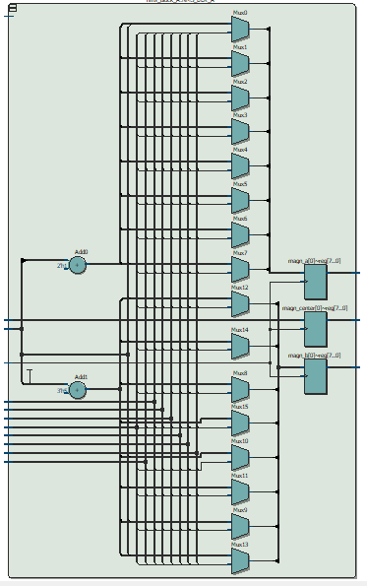
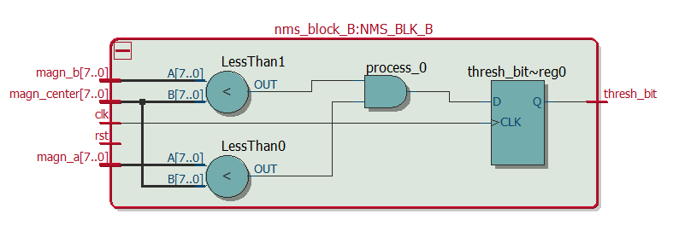
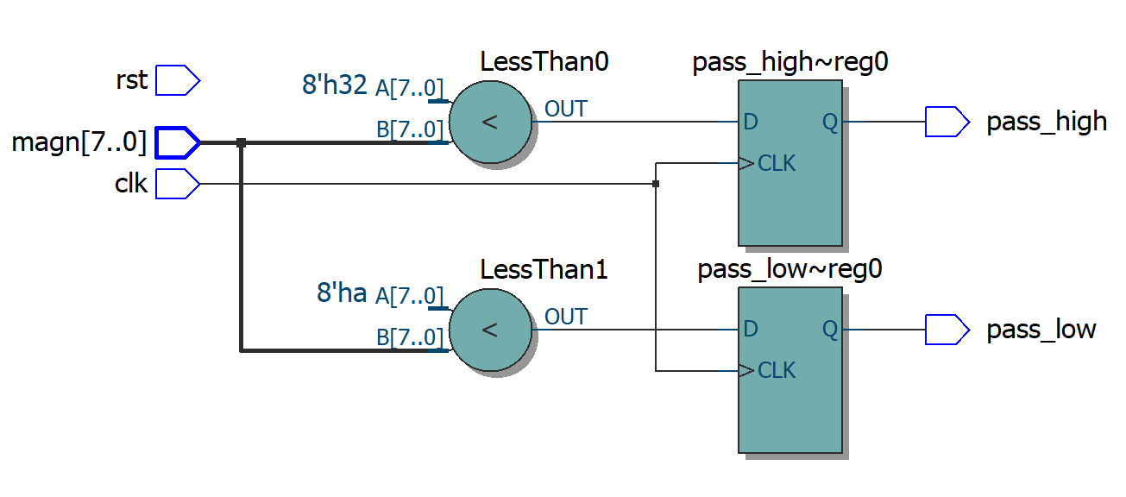
NMS Block A
NMS Block B
Thresholding Block

Slide 8
Current Progress: Datapath
TODO
NMS to thresholding linkage implementation
Datapath-to-memory and linkage
Pixel magnitude and direction conversion (from 16-bit to 8- and 3-bit integers)

